Slide 1
High-Performance Computing (HPC) in Azure
Microsoft Research

Slide 2
HPC in Azure
Run massively parallel compute jobs in the cloud
Photorealistic 3D rendering
Brute force cryptographical analysis
Engineering design and simulation
Financial risk modeling, genomics research, and more
Deploy an HPC cluster in minutes and scale as needed
Automate deployments with deployment templates
Combine with Azure Batch for batch scheduling and compute management (http://bit.ly/a4r-batch)

Slide 3
Virtual-Machine Sizes
See http://bit.ly/a4r-vm-pricing for pricing and availability
A-Series
D/DS/Dv2-Series
G/GS-Series
A8-A11 for HPC
Up to 112 GB RAM and 16 cores
Up to 16 data disks (1 TB each)
Up to 100% faster than A-series
Up to 112 GB RAM and 16 cores
Up to 32 data disks (1 TB each)
Solid-state drives
35% faster than D-series
Up to 448 GB RAM and 32 cores
Up to 64 data disks (1 TB each)
Solid-state drives
A0
A1
A2
A3
D1
D2
D3
D4
G1
G2
G3
G4
A4
A5
A6
A7
D11
D12
D13
D14
G5
A8
A9
A10
A11
D5v2
Notes:
Not all VM sizes are available in all data centers. For the latest pricing information and availability, see https://azure.microsoft.com/en-us/pricing/details/virtual-machines.

Slide 4
Azure Resource Manager
Allows complex deployments to be performed declaratively via deployment templates
Deployment templates specify all the resources — VMs, switches, storage accounts, etc. — to be provisioned
Templates can include parameters that are filled in at runtime
Learn more at http://bit.ly/a4r-arm
Allows resources to be collated into resource groups
Deploy, manage, monitor, and delete all resources at once rather than one resource at a time

Slide 5
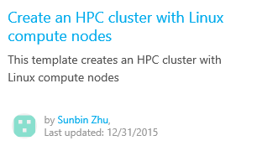
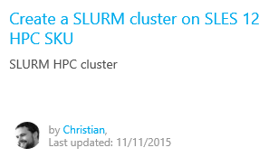
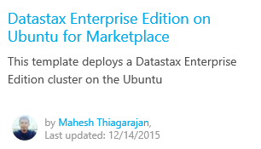
Azure Quickstart Templates
Free, open-source templates built by the community
Find them on the Azure site (http://bit.ly/a4r-quickstart)
Or browse them on GitHub (http://bit.ly/a4r-github)
Notes:
The three templates pictured here are just a few of the many dozens of templates currently available.

Slide 6
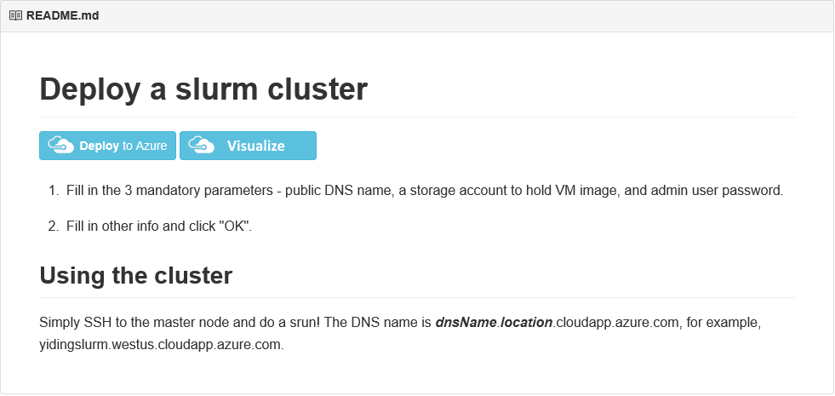
SLURM Clusters
Simple Linux Utility for Resource Management (SLURM)
Quickstart template at http://bit.ly/a4r-slurm enables easy deployment of SLURM clusters of user-specified sizes
Notes:
The Simple Linux Utility for Resource Management (SLURM), also known as the SLURM Workload Manager, is a free and open-source job scheduler for Linux that excels at distributing heavy computing workloads across clusters of machines and processors. It is used on more than half of the world's supercomputers and High-Performance Computing (HPC) clusters, and it enjoys widespread use in the research community for jobs that require significant CPU resources.

Slide 7
Hands-On Lab
Creating a SLURM Linux Cluster
SLURM Linux Cluster HOL.html

